Slide 1
Drugs, Guns and Oil:
Attacking Big Problems with Big Data
Mike Olson
CEO, Cloudera

Slide 2
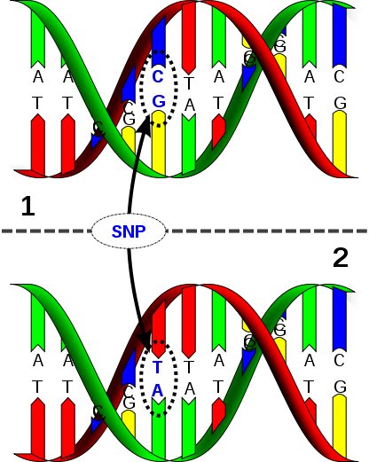
Drugs
Single-Nucleotide Polymorphism
http://en.wikipedia.org/wiki/File:Dna-SNP.svg

Slide 3
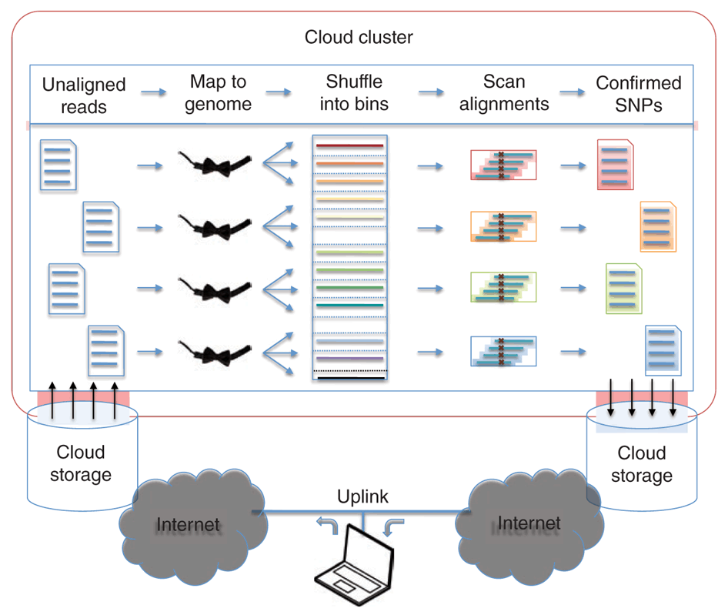
Drugs
Bowtie and Crossbow
Ben Langmead, Michael Schatz
Johns Hopkins Bloomberg
School of Public Health
Related: SoapSNP, Contrail, CloudBurst
http://www.nature.com/nbt/journal/v28/n7/fig_tab/nbt0710-691_F1.html

Slide 4
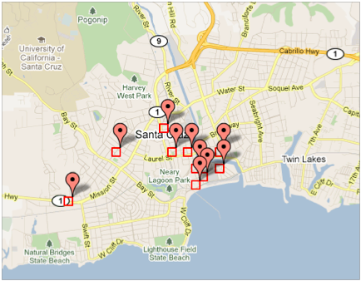
Guns
Predictive Policing
Santa Cruz, California
http://math.scu.edu/~gmohler/predpol.html

Slide 5
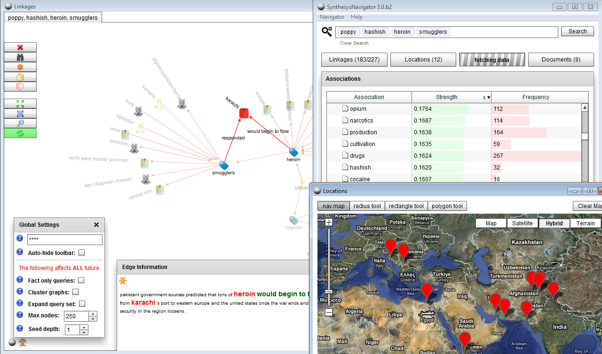
Guns
Entity Analysis
Machine Learning and Social Networking
applied to
Drug Trafficking and
Terrorism

Slide 6

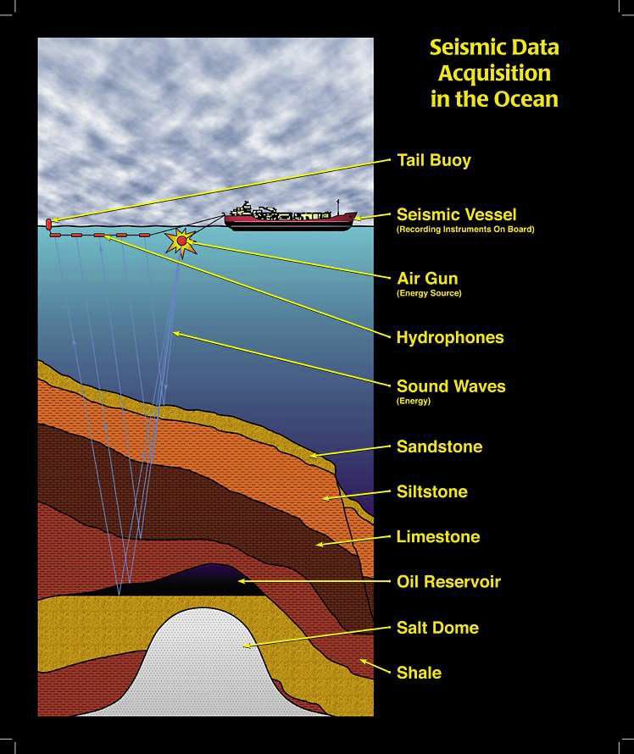
Oil
Reflection
Seismology
Bill Symes, Rice University, “Seeing Through Rock: The Mathematics of Reflection Seismology.”

Slide 7
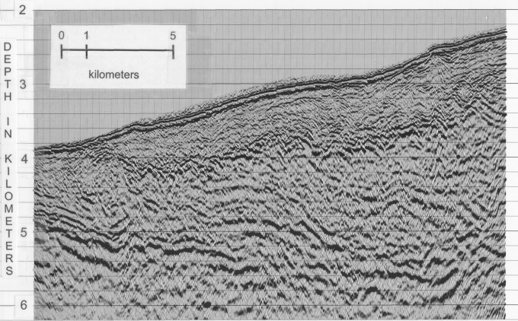
Oil
Subsurface Topography
http://walter.kessinger.com/work/images/seisx_fig5_big.jpg

Slide 8
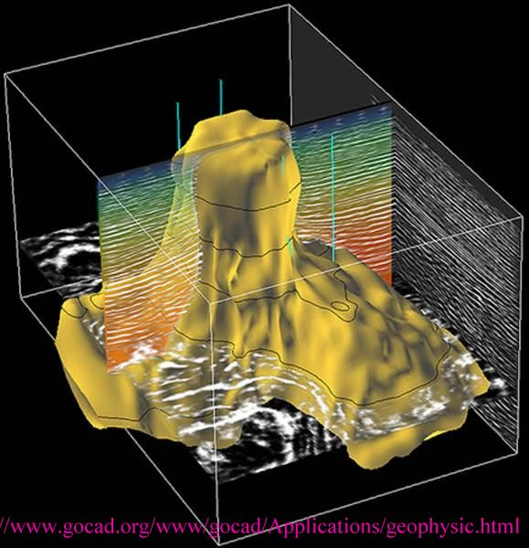
Oil
Data Analysis and Modeling
to produce
Subsurface Structure and Reservoir Maps

